Slide 1

SQL
for Beginners
(Telugu)
FULL COURSE
CSE & IT Tutorial 4u

Slide 2


What’s in this video for you? SQL Topics
Introduction to Database Theory
Introduction to SQL
Creating database & Tables in SQl
Basic Operations in SQL
SQL Built-in Functions
Aggregate & String Functions
Window Functions
Types of Joins
Triggers & Cursors
Procedures & Functions
Temporary Tables, SubQueries
Views
CSE & IT Tutorial 4u

Slide 3
01 Introduction To Database Theory
What is Database?
What is Data? What is DBMS?
What is RDBMS?
CSE & IT Tutorial 4u

Slide 4

What is Data?
Computer data is information stored by a computer. This information may be in the form of text documents, images, audio clips, software programs, or other types of data.
CSE & IT Tutorial 4u

Slide 5

What is Database?
A database is an organized collection of structured information (data), typically stored electronically in a computer system.
CSE & IT Tutorial 4u

Slide 6







Popular Database
CSE & IT Tutorial 4u

Slide 7

What is Database Management System(DBMS)?
Database Management System (DBMS) is a software for storing and retrieving users’ data
CSE & IT Tutorial 4u

Slide 8
What is RDBMS?
RDBMS is the software that executes queries on the related data, including adding, updating, and searching for values.
CSE & IT Tutorial 4u

Slide 9

Introduction to
SQL

Slide 10


SQL- Structured Query Language
Structured Query Language is a standard Database language which is used to create, maintain and retrieve the relational database.
CSE & IT Tutorial 4u

Slide 11
SQL- Structured Query Language
DDL (Data Deﬁnition Language):
The data deﬁnition language deals with the schema creation and modiﬁcation Ex: CREATE TABLE and ALTER TABLE
DML (Data Manipulation Language):
The data manipulation language provides the constructs to query data
Ex : SELECT statement and INSERT, UPDATE, and DELETE statements.
DCL (Data Control Language):
The data control language consists of the statements that deal with the user authorization and security.
Ex: GRANT and REVOKE statements.
CSE & IT Tutorial 4u

Slide 12
SQL- Structured Query Language
SQL Dialects:
Most popular dialects of SQL:
PL/SQL stands for procedural language/SQL developed by Oracle.
Transact-SQL or T-SQL is developed by Microsoft for Microsoft SQL Server.
PL/pgSQL stands for Procedural Language/PostgreSQL that consists of SQL dialect and extensions implemented in PostgreSQL
MySQL has its own procedural language since version 5. Note that MySQL was acquired by Oracle.
CSE & IT Tutorial 4u

Slide 13


Creating Database & Table in SQL

Slide 14
Creating Database & Table
Creating Database:
Syntax:
CREATE DATABASE database_name;
Example:
CREATE DATABASE Test;
CSE & IT Tutorial 4u

Slide 15
Deleting Database
Delete or Drop Database:
Syntax:
DROP DATABASE database_name; Example:
DROP DATABASE Test;
CSE & IT Tutorial 4u

Slide 16
Backup Database
Backup Database:
Syntax:
BACKUP DATABASE databasename
TO DISK = 'ﬁle path';
Example:
BACKUP DATABASE testDB
TO DISK = 'D:\backups\testDB.bak';
CSE & IT Tutorial 4u

Slide 17
Creating table
Syntax:
CREATE TABLE table_name ( column1 datatype, column2 datatype, column3 datatype,
);
Example:
CREATE TABLE Persons ( PersonID int,
LastName varchar(255), FirstName varchar(255), Address varchar(255), City varchar(255)
);
CSE & IT Tutorial 4u

Slide 18
Deleting Table
Delete or Drop Table:
Syntax:
DROP TABLE table_name; Example:
DROP TABLE Test;
CSE & IT Tutorial 4u

Slide 19
TRUNCATE Table
Truncate Table:
Syntax:
TRUNCATE TABLE table_name; Example:
TRUNCATE
TABLE Test;
CSE & IT Tutorial 4u

Slide 20
ALTER Table
ALTER TABLE - ADD Column
Syntax:
ALTER TABLE table_name
ADD column_name datatype;
Example:
ALTER TABLE Customers ADD Email varchar(255);
CSE & IT Tutorial 4u

Slide 21
ALTER Table
ALTER TABLE - DROP Column
Syntax:
ALTER TABLE table_name
DROP COLUMN column_name;
Example:
ALTER TABLE Customers DROP COLUMN Email;
CSE & IT Tutorial 4u

Slide 22
INSERT INTO QUERY
The INSERT INTO statement is used to insert new records in a table.
Insert into Syntax
INSERT INTO table_name (column1, column2, column3, ...) VALUES (value1, value2, value3, ...); INSERT INTO table_name VALUES (value1, value2, value3, ...);
Insert into Example
INSERT INTO Customers (CustomerName, ContactName, Address, City, PostalCode, Country) VALUES ('Cardinal', 'Tom B. Erichsen', 'Skagen 21', 'Stavanger', '4006', 'Norway');

Slide 23
Basic Operations in SQL

Slide 24
Basic Operations in SQL
Like
In
Between
Alias
Wildcards
Union
Exists
Any,All
Select into
Insert into select
CSE & IT Tutorial 4u
Select
Update
Delete
Where
Null Values
AND , OR, NOT
ORDER BY
GROUP BY
Insert Into
HAVING

Slide 25
DATA BASE
CustomerID | CustomerName | ContactName | Address | City | PostalCode | Country
1 | Alfreds Futterkiste | Maria Anders | Obere Str. 57 | Berlin | 12209 | Germany
2 | Ana Trujillo Emparedados y helados | Ana Trujillo | Avda. de la Constitució n 2222 | México D.F. | 05021 | Mexico
3 | Antonio Moreno Taquería | Antonio Moreno | Mataderos 2312 | México D.F. | 05023 | Mexico
4 | Around the Horn | Thomas Hardy | 120 Hanover Sq. | London | WA1 1DP | UK
5 | Berglunds snabbköp | Christina Berglund | Berguvsväg en 8 | Luleå | S-958 22 | Sweden

Slide 26
SELECT QUERY
The SELECT statement is used to select data from a database.
Two Types of SELECT’s
SELECT : The SELECT statement is used to select data from a database.
SELECT DISTINCT : The SELECT DISTINCT statement is used to return only distinct (diﬀerent) values.
CSE & IT Tutorial 4u

Slide 27
SELECT QUERY
SELECT Syntax
SELECT column1, column2, ... FROM table_name;
SELECT * FROM table_name;
SELECT EXAMPLE:
SELECT CustomerName, City FROM Customers;
SELECT * FROM Customers;
CSE & IT Tutorial 4u

Slide 28
SELECT DISTINCT
QUERY
SELECT Syntax
SELECT DISTINCT column1, column2, ... FROM table_name;
SELECT COUNT(DISTINCT Column)* FROM table_name;
SELECT EXAMPLE:
SELECT DISTINCT Country FROM Customers;
SELECT COUNT(DISTINCT Country)* FROM table_name;
CSE & IT Tutorial 4u

Slide 29
UPDATE QUERY
The UPDATE statement is used to modify the existing records in a table.
UPDATE Syntax
UPDATE table_name SET column1 = value1, column2 = value2, ...WHERE condition;
UPDATE EXAMPLE:
UPDATE Customers
SET ContactName='Juan'
WHERE Country='Mexico';
CSE & IT Tutorial 4u

Slide 30
DELETE QUERY
The DELETE statement is used to delete existing records in a table.
DELETE Syntax
DELETE FROM table_name WHERE condition;
DELETE
EXAMPLE:
DELETE FROM Customers WHERE CustomerName='Alfreds Futterkiste';
CSE & IT Tutorial 4u

Slide 31
WHERE CLAUSE QUERY
The WHERE clause is used to ﬁlter records.
It is used to extract only those records that fulﬁll a speciﬁed condition.
WHERE
Syntax
SELECT column1, column2, … FROM table_name
WHERE condition;
DELETE
EXAMPLE:
SELECT * FROM Customers
WHERE Country='Mexico';
CSE & IT Tutorial 4u

Slide 32
NULL VALUES QUERY
A ﬁeld with a NULL value is a ﬁeld with no value. If a ﬁeld in a table is optional, it is possible to insert a new record or update a record without adding a value to this ﬁeld. Then, the ﬁeld will be saved with a NULL value.
IS NULL
SELECT column_names FROM table_name WHERE column_name IS NULL;
SELECT CustomerName, ContactName, Address FROM Customers WHERE Address IS NULL;
IS NOT NULL
SELECT column_names FROM table_name WHERE column_name IS NOT NULL;
SELECT CustomerName, ContactName, Address FROM Customers WHERE Address IS NOT NULL;

Slide 33
AND QUERY
AND Syntax
SELECT column1, column2, … FROM table_name WHERE condition1 AND
condition2 AND condition3 ...;
AND Example:
SELECT * FROM Customers WHERE Country='Germany' AND City='Berlin';

Slide 34
OR QUERY
OR Syntax
SELECT column1, column2, … FROM table_name WHERE condition1 OR condition2 OR condition3
...;
OR Example:
SELECT * FROM Customers WHERE City='Berlin' OR City='München';

Slide 35
NOT QUERY
NOT Syntax
SELECT column1, column2, … FROM table_name WHERE NOT condition;
NOT Example:
SELECT * FROM Customers WHERE NOT Country='Germany';

Slide 36
ORDER BY QUERY
The ORDER BY keyword is used to sort the result-set in ascending or descending order.
The ORDER BY keyword sorts the records in ascending order by default. To sort the records in descending order, use the DESC keyword.
ORDER BY Syntax
SELECT column1, column2, … FROM table_name ORDER BY column1, column2, ... ASC|DESC;
ORDER BY Example
SELECT * FROM Customers ORDER BY Country;

Slide 37
GROUP BY QUERY
The GROUP BY statement groups rows that have the same values into summary rows, like "ﬁnd the number of customers in each country".
GROUP BY Syntax
SELECT column_name(s) FROM table_name WHERE condition GROUP BY column_name(s)
ORDER BY column_name(s);
ORDER BY Example
SELECT COUNT(CustomerID), Country FROM Customers GROUP BY Country;

Slide 38
HAVING QUERY
The HAVING clause was added to SQL because the WHERE keyword cannot be used with aggregate functions.
HAVING Syntax
SELECT column_name(s) FROM table_name WHERE condition GROUP BY column_name(s) HAVING
condition ORDER BY column_name(s);
HAVING Example
SELECT COUNT(CustomerID), Country FROM Customers GROUP BY Country HAVING COUNT(CustomerID) > 5;

Slide 39
LIKE QUERY
The LIKE operator is used in a WHERE clause to search for a speciﬁed pattern in a column.
There are two wildcards often used in conjunction with the LIKE operator:
The percent sign (%) represents zero, one, or multiple characters
The underscore sign (_) represents one, single character
LIKE Syntax
SELECT column1, column2, … FROM table_name WHERE columnN LIKE pattern;
Example
SELECT * FROM Customers WHERE CustomerName LIKE 'a%'; SELECT * FROM Customers WHERE CustomerName LIKE '%a';

Slide 40
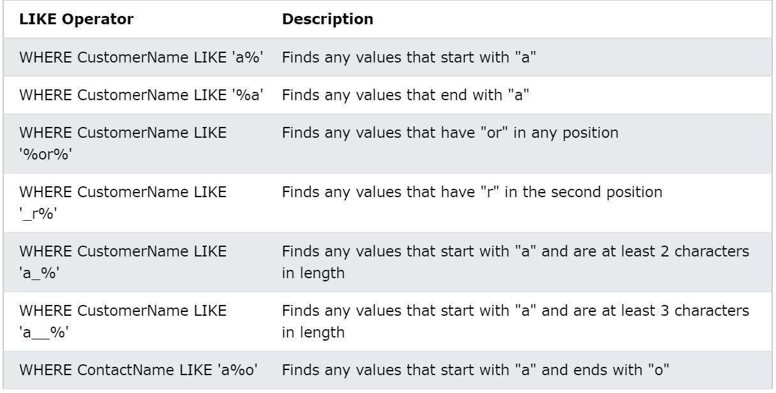
QUERY
LIKE

Slide 41
IN QUERY
The IN operator allows you to specify multiple values in a WHERE clause.
The IN operator is a shorthand for multiple OR conditions.
IN Syntax
SELECT column_name(s) FROM table_name WHERE column_name IN (value1, value2, ...);
IN Operator Examples
SELECT * FROM Customers WHERE Country IN ('Germany', 'France', 'UK');

Slide 42
BETWEEN QUERY
The BETWEEN operator selects values within a given range. The values can be numbers, text, or dates.
The BETWEEN operator is inclusive: begin and end values are included.
BETWEEN Syntax
SELECT column_name(s) FROM table_name WHERE column_name BETWEEN value1 AND
value2;
BETWEEN Example
SELECT * FROM Products WHERE Price BETWEEN 10 AND 20;

Slide 43
ALIAS QUERY
SQL aliases are used to give a table, or a column in a table, a temporary name.Aliases are often used to make column names more readable.
Alias Column Syntax
SELECT column_name AS alias_name FROM table_name;
Alias Table Syntax
SELECT column_name(s) FROM table_name AS alias_name;
Example:
SELECT CustomerID AS ID, CustomerName AS Customer FROM Customers;

Slide 44
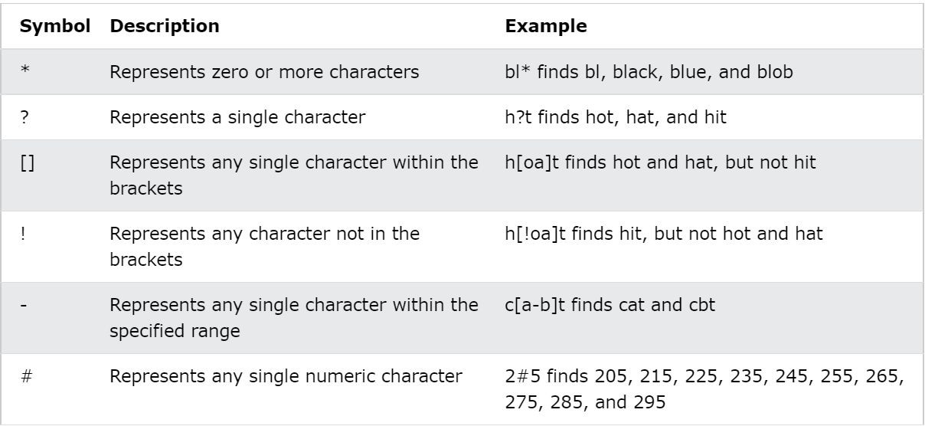
WILDCARD QUERY
A wildcard character is used to substitute one or more characters in a string. Wildcard characters are used with the LIKE operator. The LIKE operator is used in a WHERE clause to search for a speciﬁed pattern in a column.

Slide 45
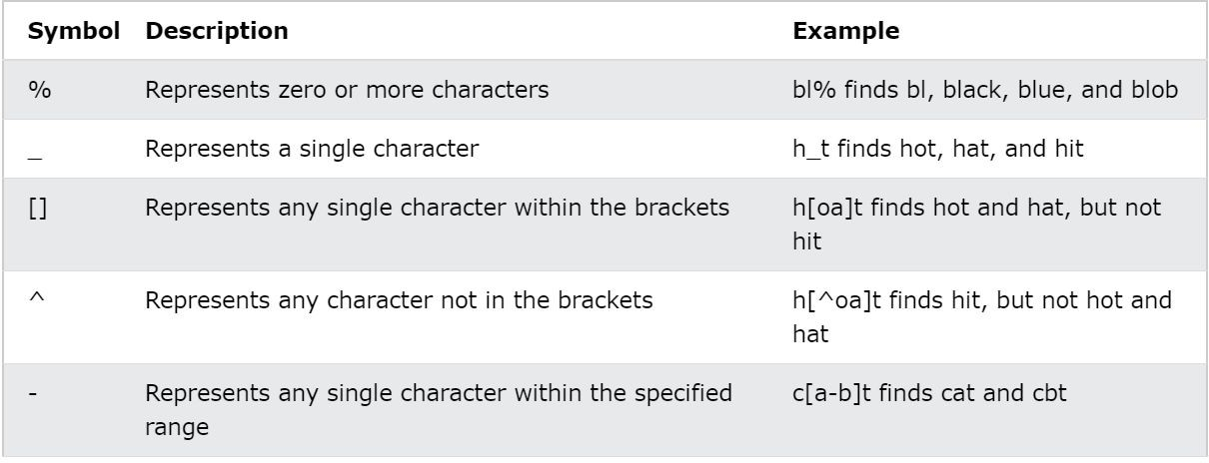
WILDCARD QUERY
SELECT * FROM Customers WHERE City LIKE 'ber%';

Slide 46
UNION QUERY
The UNION operator is used to combine the result-set of two or more SELECT statements.
UNION Syntax
SELECT column_name(s) FROM table1 UNION SELECT column_name(s) FROM table2;
UNION ALL Syntax
The UNION operator selects only distinct values by default. To allow duplicate values, use UNION ALL: SELECT column_name(s) FROM table1 UNION ALL SELECT column_name(s) FROM table2;
Example
SELECT City FROM Customers UNION SELECT City FROM Suppliers ORDER BY City;
SELECT City FROM Customers UNION ALL SELECT City FROM Suppliers ORDER BY City;

Slide 47
Exists QUERY
The EXISTS operator is used to test for the existence of any record in a subquery.
The EXISTS operator returns TRUE if the subquery returns one or more records.
EXISTS Syntax
SELECT column_name(s) FROM table_name WHERE EXISTS (SELECT column_name FROM table_name WHERE condition); Example
SELECT SupplierName FROM Suppliers WHERE EXISTS (SELECT ProductName FROM Products
WHERE Products.SupplierID = Suppliers.supplierID AND Price < 20);

Slide 48
Any QUERY
The ANY operator:
returns a boolean value as a result
returns TRUE if ANY of the subquery values meet the condition
ANY Syntax
SELECT column_name(s) FROM table_name WHERE column_name operator ANY (SELECT column_name
FROM table_name WHERE condition);
ANY Example
SELECT ProductName FROM Products WHERE ProductID = ANY (SELECT ProductID FROM OrderDetails WHERE Quantity = 10);

Slide 49
ALL QUERY
The ALL operator:
returns a boolean value as a result
returns TRUE if ALL of the subquery values meet the condition
is used with SELECT, WHERE and HAVING statements
ALL Syntax With SELECT
SELECT ALL column_name(s) FROM table_name WHERE condition; ALL Syntax With WHERE or HAVING
SELECT column_name(s) FROM table_name WHERE column_name operator ALL (SELECT column_name FROM table_name WHERE
condition);
ALL EXAMPLE:
SELECT ALL ProductName FROM Products WHERE TRUE;
SELECT ProductName FROM Products WHERE ProductID = ALL (SELECT ProductID FROM OrderDetails WHERE Quantity = 10)

Slide 50

Numeric Functions

Slide 51
Built-in functions in SQL
ABS
POWER
ROUND
SIN
COS
TRUNC
TAN
ASIN
ACOS
ATAN
SQRT
SQUARE
EXP
LN
LOG
CEILING
FLOOR
SIGN
CSE & IT Tutorial 4u

Slide 52
ABS QUERY
The ABS() function returns the absolute value of a number.
Syntax ABS(number)
Example
Find the absolute value of a number:
SELECT Abs(-243.5) AS AbsNum;

Slide 53
POWER QUERY
The POWER() function returns the value of a number raised to the power of another number.
Syntax
POWER(a, b)
Example
Return 4 raised to the second power: SELECT POWER(4, 2);

Slide 54
ROUND QUERY
The ROUND() function rounds a number to a speciﬁed number of decimal places.
Syntax
ROUND(number, decimals, operation)
Example
Round the number to 2 decimal places: SELECT ROUND(235.415, 2) AS RoundValue;

Slide 55
SIN QUERY
The SIN() function returns the sine of a number.
Syntax
SIN(number)
Example
Return the sine of a number: SELECT SIN(2);

Slide 56
COS QUERY
The COS() function returns the cosine of a number.
Syntax COS(number) Example
Return the cosine of a number: SELECT COS(2);

Slide 57
TRUNCATE
QUERY
TRUNCATE TABLE command deletes the data inside a table, but not the table itself.
The following SQL truncates the table "Categories":
Example
TRUNCATE TABLE Categories;

Slide 58
TAN QUERY
The TAN() function returns the tangent of a number.
Syntax TAN(number) Example
Return the tangent of a number: SELECT TAN(1.75);

Slide 59
SQRT
QUERY
The SQRT() function returns the square root of a number.
Syntax SQRT(number) Example
Return the square root of a number: SELECT SQRT(64);

Slide 60
SQUARE QUERY
The SQUARE() function returns the square of a number.
Syntax
SQUARE(number)
EXAMPLE
Return the square of a number: SELECT SQUARE(64);

Slide 61
EXP QUERY
The EXP() function returns e raised to the power of a speciﬁed number.
The constant e (2.718281...), is the base of natural logarithms.
Syntax
EXP(number)
Example
Return e raised to the power of 1: SELECT EXP(1);

Slide 62
LN QUERY
LN() function
SQL LN() function returns the natural logarithm of n, where n is greater than 0 and its base is number equal to approximately 2.71828183.
Syntax:
LN(expression)
Example
SELECT LN(65) "natural_log of 65"

Slide 63
LOG QUERY
The LOG() function returns the natural logarithm of a speciﬁed number, or the logarithm of the
number to the speciﬁed base.
Syntax
LOG(number, base) -- Syntax for SQL Server
OR:
LOG(number) -- Syntax for Azure SQL Database, Azure SQL Data Warehouse, Parallel Data Warehouse
Example
Return the natural logarithm of 2: SELECT LOG(2);

Slide 64
CEILING QUERY
The CEILING() function returns the smallest integer value that is larger than or equal to a number.
Syntax CEILING(number) Example
Return the smallest integer value that is greater than or equal to a number: SELECT CEILING(25.75) AS CeilValue;

Slide 65
FLOOR QUERY
The FLOOR() function returns the largest integer value that is smaller than or equal to a number.
Tip: Also look at the CEILING() and ROUND() functions.
Syntax
FLOOR(number)
Example
Return the largest integer value that is equal to or less than 25.75: SELECT FLOOR(25.75) AS FloorValue;

Slide 66
SIGN QUERY
The SIGN() function returns the sign of a number.
This function will return one of the following:
If number > 0, it returns 1
If number = 0, it returns 0
If number < 0, it returns -1
Syntax SIGN(number) Example
Return the sign of a number: SELECT SIGN(255.5);

Slide 67
SQL AGGREGATE
Functions

Slide 68
Aggregation functions in SQL
Min
Max
Average
Count
Sum
CSE & IT Tutorial 4u

Slide 69
MIN QUERY
The MIN() function returns the smallest value of the selected column. MIN() Syntax
SELECT MIN(column_name) FROM table_name WHERE condition; MIN() Example
SELECT MIN(Price) AS SmallestPrice FROM Products;

Slide 70
MAX QUERY
The MAX() function returns the largest value of the selected column. MAX() Syntax
SELECT MAX(column_name) FROM table_name WHERE condition; MAX() Example
SELECT MAX(Price) AS LargestPrice FROM Products;

Slide 71
AVERAGE QUERY
The AVG() function returns the average value of a numeric column.
AVG() Syntax
SELECT AVG(column_name) FROM table_name WHERE condition; AVG() Example
SELECT AVG(Price) FROM Products;

Slide 72
COUNT QUERY
The COUNT() function returns the number of rows that matches a speciﬁed criterion.
COUNT() Syntax
SELECT COUNT(column_name) FROM table_name WHERE condition; COUNT() Example
SELECT COUNT(ProductID) FROM Products;

Slide 73
SUM QUERY
The SUM() function returns the total sum of a numeric column.
SUM() Syntax
SELECT SUM(column_name) FROM table_name WHERE condition; SUM() Example
SELECT SUM(Quantity) FROM OrderDetails;

Slide 74
String Functions

Slide 75
String functions in SQL
INITCAP
LOWER
UPPER
CONCAT
LPAD
RPAD
LTRIM
RTRIM
REPLACE
SUBSTR
LENGTH
INSTR
CSE & IT Tutorial 4u

Slide 76
INITCAP QUERY
SQL INITCAP() Function return capitalize string/char (capitalize ﬁrst letter of each word).
Syntax
INITCAP(string)
Example
Consider following example return the capitalize string of given string argument.
SQL> SELECT INITCAP('opal kole') "INITCAP" FROM DUAL;
INITCAP
Opal Kole

Slide 77
LOWER QUERY
The LOWER() function converts a string to lower-case.
Syntax LOWER(text)
Convert the text to lower-case:
SELECT LOWER('SQL Tutorial is FUN!');

Slide 78
UPPER QUERY
The UPPER() function converts a string to upper-case.
Syntax
UPPER(text)
Example
Convert the text to upper-case:
SELECT UPPER('SQL Tutorial is FUN!');

Slide 79
CONCAT QUERY
The CONCAT() function adds two or more strings together.
Syntax
CONCAT(string1, string2, ...., string_n)
Example
Add two strings together:
SELECT CONCAT('google', '.com');
Output : google.com

Slide 80
LTRIM QUERY
The Note LTRIM() function removes leading spaces from a string.
Syntax
LTRIM(string)
Example
Remove leading spaces from a string:
SELECT LTRIM(" SQL Tutorial") AS LeftTrimmedString;

Slide 81
RTRIM QUERY
The RTRIM() function removes trailing spaces from a string.
Syntax
RTRIM(string)
Example
Remove trailing spaces from a string: SELECT RTRIM("SQL Tutorial
") AS RightTrimmedString;

Slide 82
REPLACE QUERY
The REPLACE() function replaces all occurrences of a substring within a string, with a new substring.
Note: This function performs a case-sensitive replacement.
Syntax
REPLACE(string, from_string, new_string)
Example
Replace "SQL" with "HTML":
SELECT REPLACE("SQL Tutorial", "SQL", "HTML");

Slide 83
SUBSTR QUERY
The SUBSTR() function extracts a substring from a string (starting at any position).
Syntax
SUBSTR(string, start, length)
OR
SUBSTR(string FROM start FOR length)
Example
Extract a substring from a string (start at position 5, extract 3 characters): SELECT SUBSTR("SQL Tutorial", 5, 3) AS ExtractString;

Slide 84
LENGTH QUERY
The LENGTH() function returns the length of a string (in bytes).
Syntax
LENGTH(string)
Example
Return the length of the string, in bytes:
SELECT LENGTH("SQL Tutorial") AS LengthOfString;

Slide 85
INSTR QUERY
The INSTR() function returns the position of the ﬁrst occurrence of a string in another string.
This function performs a case-insensitive search.
Syntax
INSTR(string1, string2)
Example
Search for "3" in string "W3Schools.com", and return position: SELECT INSTR(“google.com", "g") AS MatchPosition;

Slide 86
Window Functions

Slide 87
Window functions in SQL
OVER
COUNT
SUM
ROW-NUMBER
RANK
DENSE-RANK
LEAD
LAG
CSE & IT Tutorial 4u

Slide 88
OVER QUERY
The OVER clause is used to determine which rows from the query are applied to the function, what order they are evaluated in by that function
The syntax of the OVER clause is:
<function> OVER ( [PARTITION BY clause] [ORDER BY clause]
[ROWS or RANGE clause])
Example:
select Object_id , [min]
= min(object_id) over() , [max]
= max(object_id) over()
from sys.objects

Slide 89
COUNT QUERY
The COUNT() function returns the number of records returned by a select query.
Note: NULL values are not counted.
Syntax COUNT(expression) Example
Return the number of products in the "Products" table:
SELECT COUNT(ProductID) AS NumberOfProducts FROM Products;

Slide 90
SUM QUERY
The SUM() function calculates the sum of a set of values.
Note: NULL values are ignored.
Syntax
SUM(expression)
Example
Return the sum of the "Quantity" ﬁeld in the "OrderDetails" table: SELECT SUM(Quantity) AS TotalItemsOrdered FROM OrderDetails;

Slide 91
ROW NUMBER QUERY
SQL statement shows the equivalent example using ROWNUM ():
Example
SELECT * FROM Customers
WHERE ROWNUM <= 3;

Slide 92
RANK QUERY
The RANK() function is a window function that assigns a rank to each row within a partition of a result set.
Syntax
RANK() OVER ( [PARTITION BY partition_expression, ... ] ORDER BY sort_expression [ASC | DESC], ... )
Example
SELECT v, RANK ()
OVER ( ORDER BY v )
rank_no FROM sales.rank_demo;

Slide 93
DENSE RANK QUERY
The DENSE_RANK() is a window function that assigns a rank to each row within a partition of a result set. Unlike the RANK() function, the DENSE_RANK() function returns consecutive rank values. Rows in each partition receive the same ranks if they have the same values.
Syntax of the DENSE_RANK() function
DENSE_RANK() OVER ([PARTITION BY partition_expression, ... ] ORDER BY sort_expression [ASC | DESC], ... )
Example:
CREATE TABLE sales.dense_rank_demo ( v VARCHAR(10) ); INSERT INTO sales.dense_rank_demo(v) VALUES('A'),('B'),('B'),('C'),('C'),('D'),('E');
SELECT * FROM sales.dense_rank_demo;

Slide 94
LEAD QUERY
LEAD() is a window function that provides access to a row at a speciﬁed physical oﬀset which follows the current row. By using the LEAD() function, from the current row, you can access data of the next row, or the row after the next row, and so on.
Syntax:
LEAD(return_value ,oﬀset [,default])
OVER ( [PARTITION BY partition_expression, ... ] ORDER BY sort_expression [ASC | DESC], ... ) Example:
SELECT month, net_sales, LEAD(net_sales,1) OVER ( ORDER BY month ) next_month_sale

Slide 95
LAG QUERY
LAG() is a window function that provides access to a row at a speciﬁed physical oﬀset which comes before the current row.
By using the LAG() function, from the current row, you can access data of the previous row, or the row before the previous row, and so on.
Syntax:
LAG(return_value ,oﬀset [,default])
OVER ( [PARTITION BY partition_expression, ... ] ORDER BY sort_expression [ASC | DESC], ... )
Example:
SELECT month, brand_name, net_sales, LAG(net_sales,1) OVER ( PARTITION BY brand_name ORDER BY month ) previous_sales FROM sales.vw_netsales_brands WHERE year = 2018

Slide 96
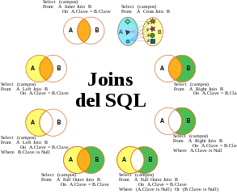
Types of Joins

Slide 97
Joins
SQL JOINS are used to retrieve data from multiple tables. A SQL JOIN is performed when two or more tables are combined in a SQL statement.
There are 4 diﬀerent types of SQL joins:
SQL INNER JOIN (sometimes called simple join)
SQL LEFT OUTER JOIN (sometimes called LEFT JOIN)
SQL RIGHT OUTER JOIN (sometimes called RIGHT JOIN)
SQL FULL OUTER JOIN (sometimes called FULL JOIN)
CSE & IT Tutorial 4u

Slide 98
Joins
SQL INNER JOIN (simple join)
It is the most common type of SQL join. SQL INNER JOINS return all rows from multiple tables where the join condition is met.
Syntax
The syntax for the INNER JOIN in SQL is:
SELECT columns
FROM table1
INNER JOIN table2
ON table1.column = table2.column;
CSE & IT Tutorial 4u

Slide 99
Joins
SQL LEFT OUTER JOIN
Another type of join is called a LEFT OUTER JOIN. This type of join returns all rows from the LEFT-hand table speciﬁed in the ON condition and only those rows from the other table where the joined ﬁelds are equal (join condition is met).
Syntax:
The syntax for the LEFT OUTER JOIN in SQL is:
SELECT columns
FROM table1
LEFT [OUTER] JOIN table2
ON table1.column = table2.column;
CSE & IT Tutorial 4u

Slide 100
Joins
SQL RIGHT OUTER JOIN
Another type of join is called a SQL RIGHT OUTER JOIN. This type of join returns all rows from the RIGHT-hand table speciﬁed in the ON condition and only those rows from the other table where the joined ﬁelds are equal (join condition is met).
Syntax
The syntax for the RIGHT OUTER JOIN in SQL is:
SELECT columns
FROM table1
RIGHT [OUTER] JOIN table2
ON table1.column = table2.column;
CSE & IT Tutorial 4u

Slide 101
Joins
SQL FULL OUTER JOIN
Another type of join is called a SQL FULL OUTER JOIN. This type of join returns all rows from the LEFT-hand table and RIGHT-hand table with NULL values in place where the join condition is not met.
Syntax
The syntax for the SQL FULL OUTER JOIN is:
SELECT columns
FROM table1
FULL [OUTER] JOIN table2
ON table1.column = table2.column;
CSE & IT Tutorial 4u

Slide 102
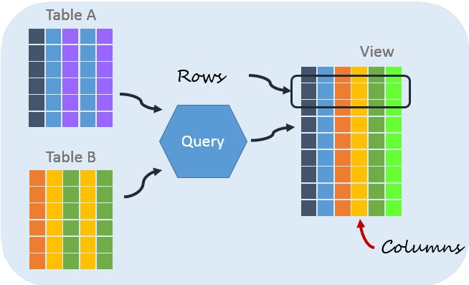
Temporary Tables, SubQueries

Slide 103
Temporary Tables
Temporary tables are stored in tempdb. They work like a regular table in that you can perform the operations select, insert and delete as for a regular table.
They are speciﬁed with the preﬁx #, for example #table_name There are 2 Types of Temporary Tables:
1 . Local Temporary Tables
2. Global Temporary Tables
CSE & IT Tutorial 4u

Slide 104
Local Temporary Table
Local Temporary tables :
Local temporary tables are the tables stored in tempdb. Local temporary tables are temporary tables that are available only to the session that created them. They are
speciﬁed with the preﬁx # Syntax
CREATE PROCEDURE sp_create_tempt
AS
CREATE TABLE #temp1
(c1 INT);
create table #table_name
(
CREATE PROCEDURE sp_use_tempt
AS BEGIN
column_name varchar(20),
column_no int
EXEC sp_create_tempt
SELECT * FROM ##temp1
)
END
CSE & IT Tutorial 4u

Slide 105
Global Temporary Table
Global Temporary Table:
Global temporary tables are also stored in tempdb. Global temporary tables are temporary tables that are available to all sessions and all users. They are speciﬁed with the preﬁx #, for example ##table_name.
Syntax
create table ##table_name
(
CREATE TABLE ##temp1
(c1 INT);
INSERT INTO ##temp1
VALUES (1);
column_name varchar(20),
column_no int
)
CSE & IT Tutorial 4u

Slide 106
Sub Queries
A subquery is a SQL query nested inside a larger query.
A subquery may occur in : SELECT, FROM, WHERE Clause
The subquery can be nested inside a SELECT, INSERT, UPDATE, or DELETE statement or inside another subquery.
A subquery is usually added within the WHERE Clause of another SQL SELECT statement.
You can use the comparison operators, such as >, <, or =. The comparison operator can also be a multiple-row operator, such as IN, ANY, or ALL.
CSE & IT Tutorial 4u

Slide 107
Sub Queries
Type of Subqueries
Single row subquery : Returns zero or one row.
Multiple row subquery : Returns one or more rows.
Multiple column subqueries : Returns one or more columns.
Correlated subqueries : Reference one or more columns in the outer SQL statement. The subquery is known as a correlated subquery because the subquery is related to the outer SQL statement.
Nested subqueries : Subqueries are placed within another subquery.
CSE & IT Tutorial 4u

Slide 108
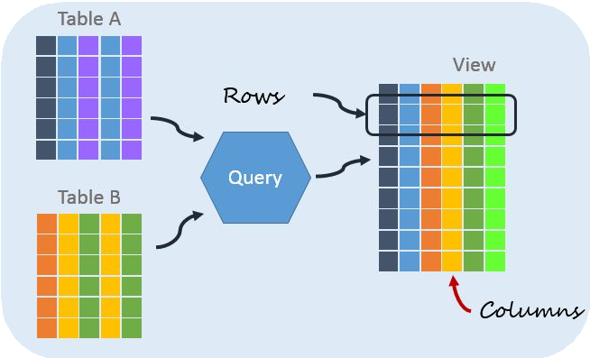
Views

Slide 109
Creating a View
Views in SQL are kind of virtual tables. A view also has rows and columns as they are in a real table in the database. We can create a view by selecting ﬁelds from one or more tables present in the database. A View can either have all the rows of a table or speciﬁc rows based on certain condition.
Syntax:
CREATE VIEW view_name AS SELECT column1, column2..... FROM table_name
WHERE condition;
view_name: Name for the View table_name: Name of the table condition: Condition to select rows
Example
CREATE VIEW [Brazil Customers] AS SELECT CustomerName, ContactName FROM Customers
WHERE Country = 'Brazil';
CSE & IT Tutorial 4u

Slide 110
Deleting a View
We have learned about creating a View, but what if a created View is not needed any more? Obviously we will want to delete it. SQL allows us to delete an existing View. We can delete or drop a View using the DROP statement.
Syntax:
DROP VIEW view_name;
Example
DROP VIEW [Brazil Customers];
CSE & IT Tutorial 4u

Slide 111
Update a View
There are certain conditions needed to be satisﬁed to update a view. If any one of these conditions is not met, then we will not be allowed to update the view.
Syntax:
CREATE OR REPLACE VIEW view_name AS SELECT column1, column2, ..
FROM table_name WHERE condition;
Example
CREATE OR REPLACE VIEW [Brazil Customers] AS SELECT CustomerName, ContactName, City
FROM Customers
WHERE Country = 'Brazil';
CSE & IT Tutorial 4u

Slide 112
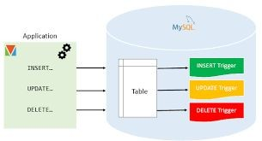
Triggers & Cursors

Slide 113
Triggers & Cursors
Triggers :
A trigger is a block of code that is executed automatically from a database statement. Triggers is generally executed for DML statements such as INSERT, UPDATE or DELETE.
SYNTAX :
CREATE OR REPLACE TRIGGER <trigger-name>
[BEFORE/AFTER] [INSERT/UPDATE/DELETE]
OF<column-name>
ON<table-name>
[REFERENCING OLD AS O NEW AS N]
[FOR EACH ROW]
WHEN <trigger-condition>
DECLARE
BEGIN
<sql-statement>
CSE & IT Tutorial 4u
END;

Slide 114
Triggers & Cursors
Cursors :
A cursor in SQL is a temporary work area created in system memory when a SQL statement is executed. A SQL cursor is a set of rows together with a pointer that identiﬁes a current row. It is a database object to retrieve data from a result set one row at a time.
Types of Cursors in SQL
There are the following two types of cursors in SQL:
Implicit Cursor
Explicit Cursor
CSE & IT Tutorial 4u

Slide 115
Triggers & Cursors
Main components of Cursors
Each cursor contains the followings 5 parts,
Declare Cursor: In this part, we declare variables and return a set of values.
Open: This is the entering part of the cursor.
Fetch: Used to retrieve the data row by row from a cursor.
Close: This is an exit part of the cursor and used to close a cursor.
Deallocate: In this part, we delete the cursor deﬁnition and release all the system resources associated with the cursor.
CSE & IT Tutorial 4u

Slide 116
Triggers & Cursors
Cursor Scope
Microsoft SQL Server supports the GLOBAL and LOCAL keywords on the DECLARE CURSOR statement to deﬁne the scope of the cursor name.
GLOBAL - speciﬁes that the cursor name is global to the connection.
LOCAL - speciﬁes that the cursor name is local to the Stored Procedure, trigger, or query that holds the cursor.
Data Fetch Option in Cursors
Microsoft SQL Server supports the following two fetch options for data:
FORWARD_ONLY - Speciﬁes that the cursor can only be scrolled from the ﬁrst to the last row.
SCROLL - It provides 6 options to fetch the data (FIRST, LAST, PRIOR, NEXT, RELATIVE, and
ABSOLUTE).
CSE & IT Tutorial 4u

Slide 117
Procedures

Slide 118
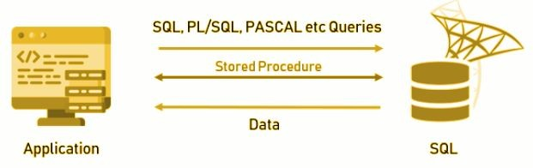
Procedures
What is a Procedure?
Procedures are the subprograms which can be created and saved in the database as database objects.
A procedure in SQL (often referred to as stored procedure), is a reusable unit that encapsulates the speciﬁc business logic of the application. A SQL procedure is a group of SQL statements and logic, compiled and stored together to perform a speciﬁc task.
CSE & IT Tutorial 4u

Slide 119
Procedures
Procedure Syntax:
CREATE [ OR REPLACE] PROCEDURE procedure_name [ (parameter_name [IN | OUT | IN OUT] type [ ])]
{IS | AS }
BEGIN [declaration_section] executable_section
//SQL statement used in the stored procedure END
GO
CSE & IT Tutorial 4u

Slide 120
THANK YOU

Slide 121

What’s in this video for you? DBMS Topics
Introduction to Database Theory
DBMS Architecture
Relational Data Model
ER Diagrams
Relational Algebra in DBMS
Transaction Management
Concurrency Control in DBMS
Keys in DBMS
Dependencies, Independencies
File Structure
CSE & IT Tutorial 4u

Slide 122
01
Introduction
To Database Theory

Slide 123
Diﬀerence Between DBMS, RDBMS
DBMS | RDBMS
Data stored is in the ﬁle format | Data stored is in table format
No support for distributed database | Support distributed database
Data stored is a small quantity | Data is stored in a large amount
DBMS supports a single user | RDBMS supports multiple users
Individual access of data elements | Multiple data elements are accessible together
No connection between data | Data in the form of a table are linked together
There is normalisation | Normalisation is not achievable
XML, Microsoft Access. | Oracle, SQL Server.
CSE & IT Tutorial 4u

Slide 124

DBMS Advantages
Reducing Data Redundancy
Sharing of Data
Data Integrity
Data Security
Privacy
Backup and Recovery
Data Consistency
CSE & IT Tutorial 4u

Slide 125
DBMS Disadvantages
Increased Cost
Complexity
Currency Maintenance
Database Failure
Huge Size
Diﬃcult Backup And Recovery
Conﬁdentiality, Privacy, and Security
CSE & IT Tutorial 4u

Slide 126
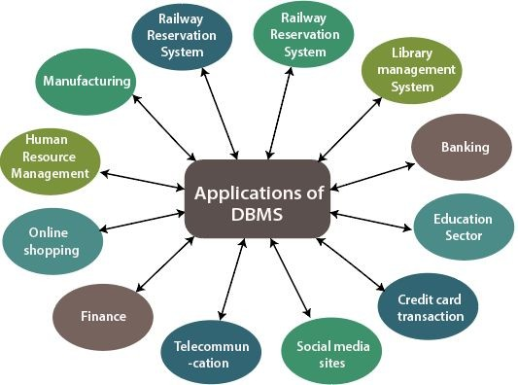
DBMS Applications
CSE & IT Tutorial 4u

Slide 127
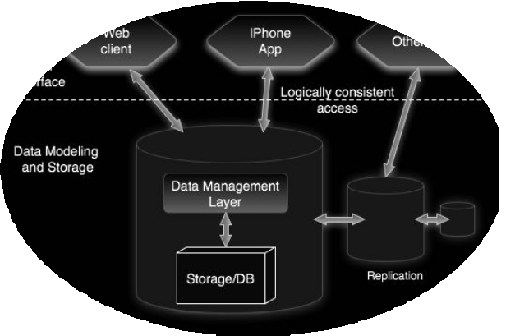
02
DBMS
Architecture

Slide 128
02 DBMS Architecture
DBMS Architecture
Types of DBMS Architecture
One Tier Architecture Two Tier Architecture
Three Tier Architecture
Database Schema
CSE & IT Tutorial 4u

